Slide 1
Radar Datasets

Slide 2
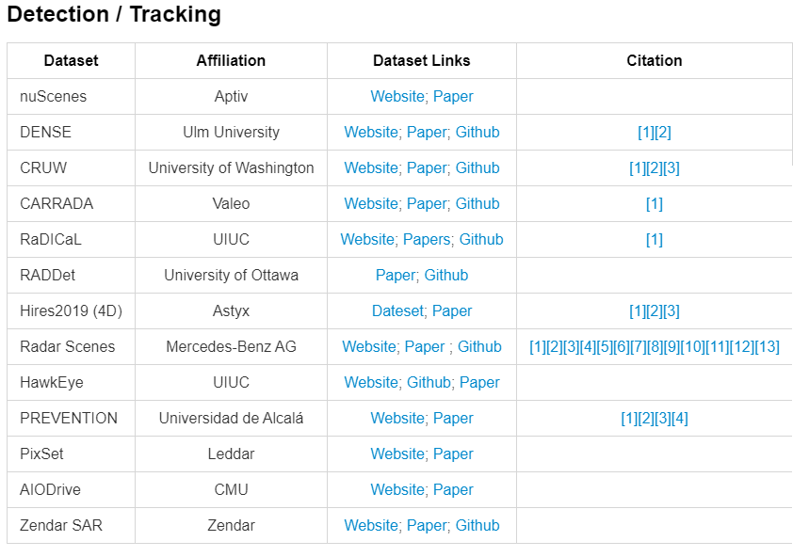
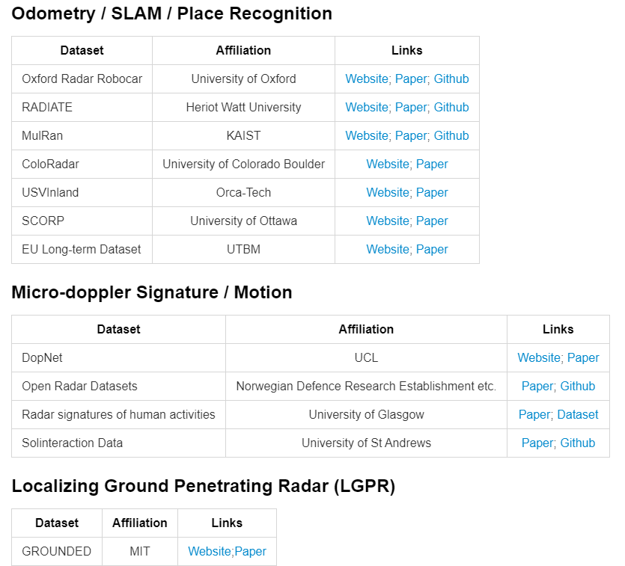
Overall

Slide 3
Sparse Pointclouds
1. NuScenes: 5.5 hours(39k frames) 1000 scenes
2. PixSet: 29k frames, 97 scenes
3. DENSE: 12k frames
4. RadarScenes: 4 hours, 158 scenes
5. CaRINA
6. PREVENTION

Slide 4
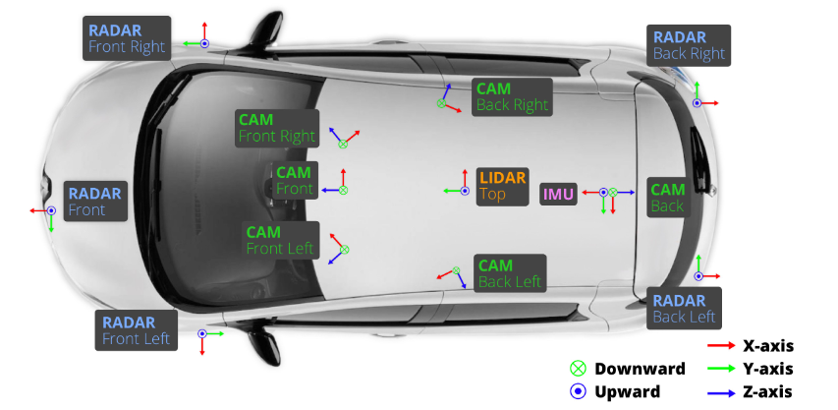
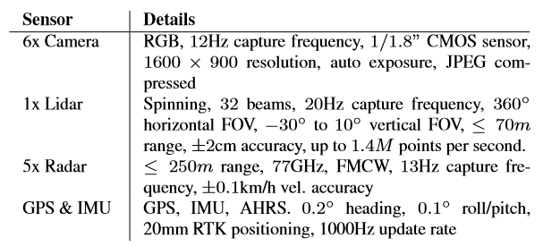
1. NuScenes: Sensors
Also with HD localization map and semantic map

Slide 5
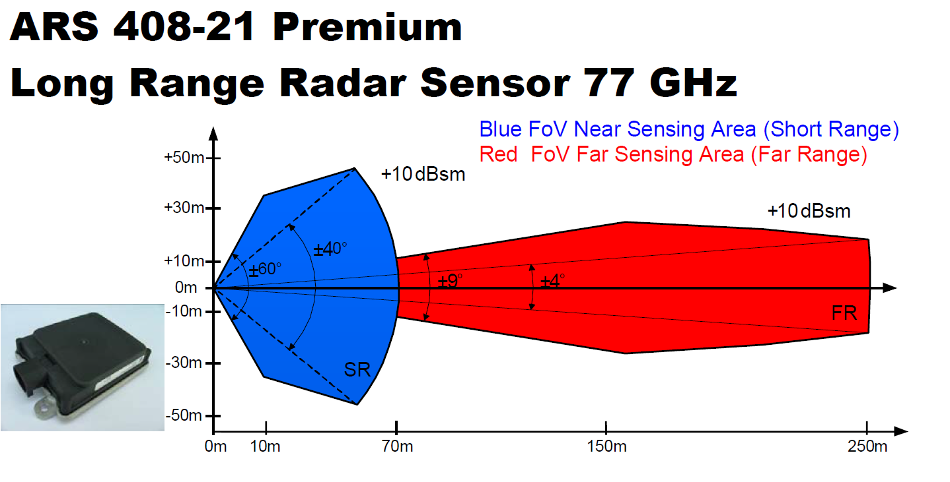
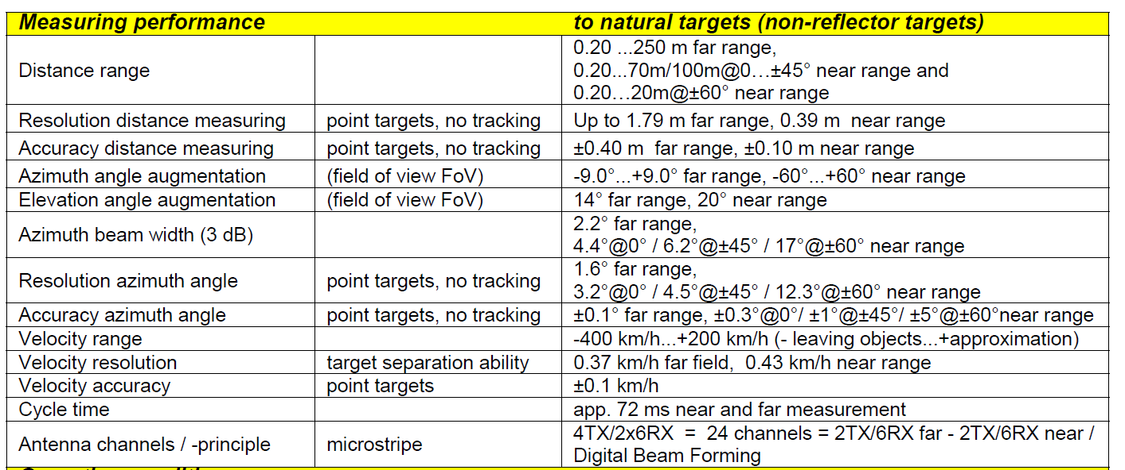
NuScenes: Radar

Slide 6
NuScenes: Data
Slow moving capturing car (avg speed 16km/h)
84 logs with 15h of driving data (242km)
manually select 1000 interesting scenes of 20s duration each (5.5h in total)
Including adverse weather
23 classes with a semantic category, attributes (visibility, activity, and pose) and a 3D bounding box (1.4M in total)
also release intermediate sensor frames for tracking

Slide 7
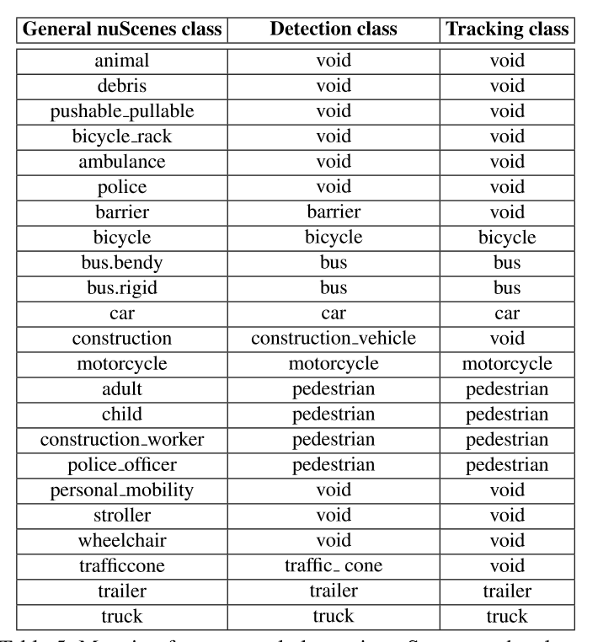
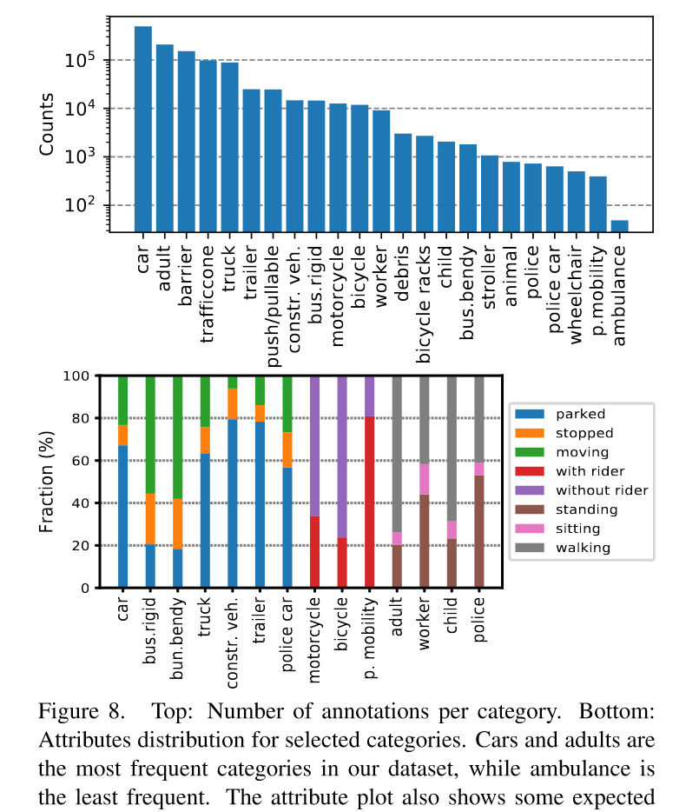
NuScenes: Class
23 classes, 3D annotations
Severe class imbalance

Slide 8
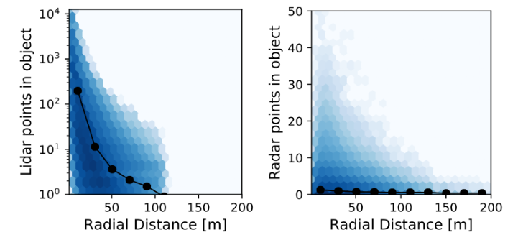
NuScenes: Distance
Image: maximum 80m
Lidar: maximum 100 pts at 80m
Radar:
40 pts at 10m
10 pts at 50m
maximum 200m

Slide 9
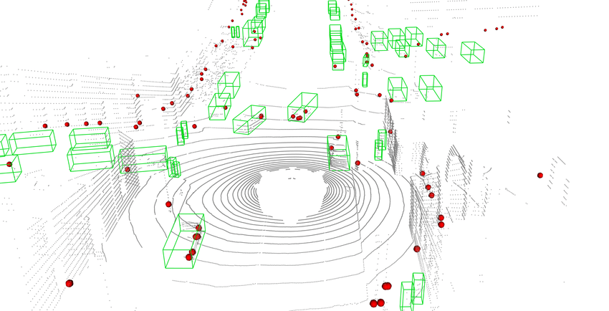
NuScenes: Sample

Slide 10
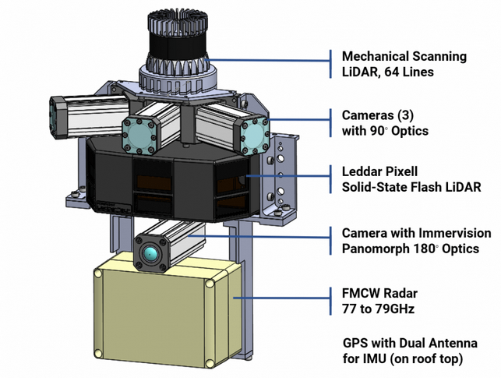
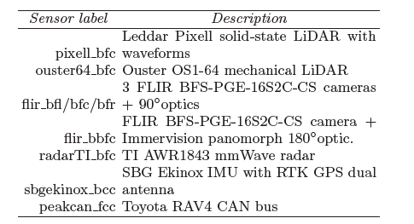
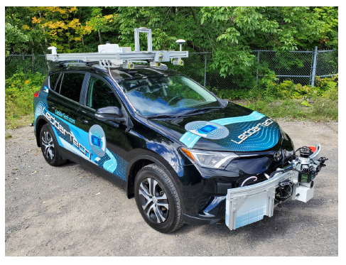
2. PixSet: Sensors

Slide 11
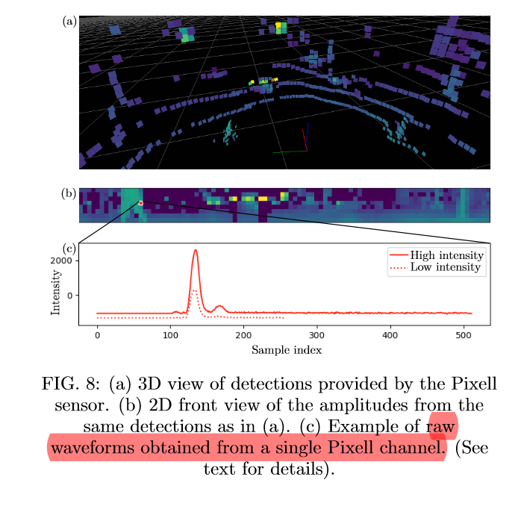
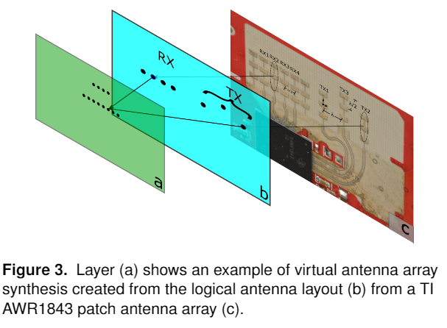
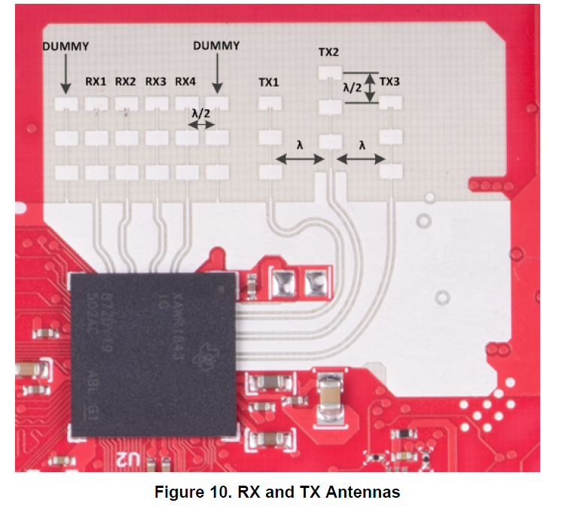
PixSet: Radar & Solid-State Lidar
Provide raw waveform information of the solid-state lidar:
A waveform is the measured intensity as a function of time after the emission of the laser pulse from the LiDAR
A point is the result of a peak found in a waveform.
AWR1843: mid-range radar out-door radar
3Tx, 4Rx
150m maximum range
elevation resolution

Slide 12
PixSet: Data
29k frames from 97 sequences
Urban areas
thousand frames were recorded at night and/or while raining
22 classes with 3D bounding boxes annotations
Accurate bounding box size for pedestrians

Slide 13
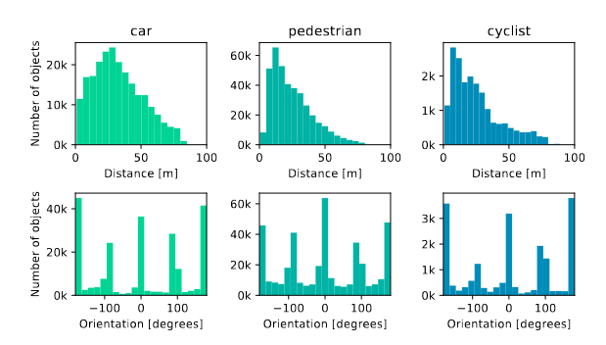
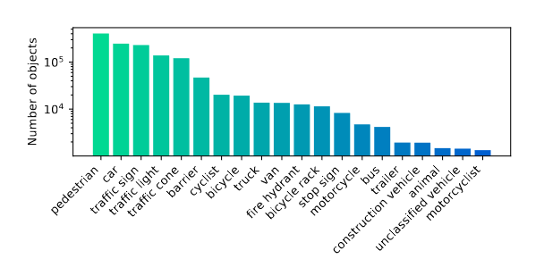
PixSet: Class & Distance

Slide 14
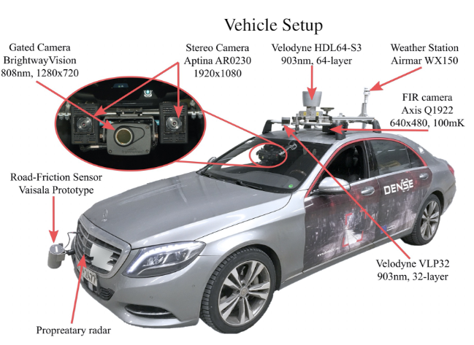
3. DENSE: Sensors
77Ghz Radar with 1 ° angular resolution and distances up to 200 m, 15Hz

Slide 15
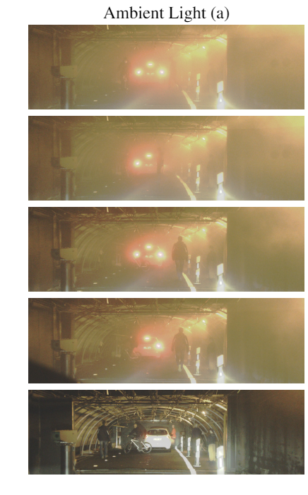
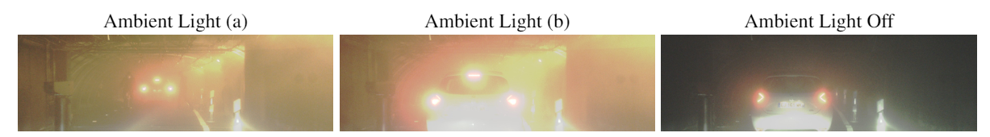
DENSE: Data
Real-world Recordings
1.4 million raw frames at 10 Hz under different weather and illumination condition are collected
12k annotated frames with balanced scenes : 5.5k clear weather, 1k dense fog, 1k light fog, and 4k snow/rain
Controlled Condition Recordings in Fog Chamber
1.5k frames under two different illumination conditions (day/night) and three fog densities with meteorological visibilities of 30 m, 40 m and 50 m.

Slide 16
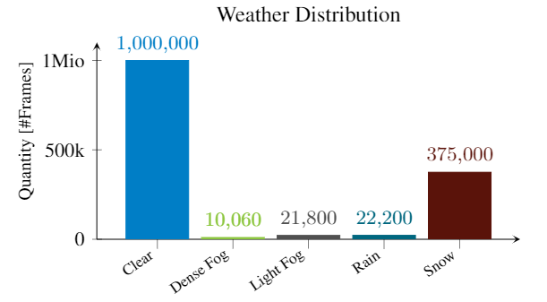
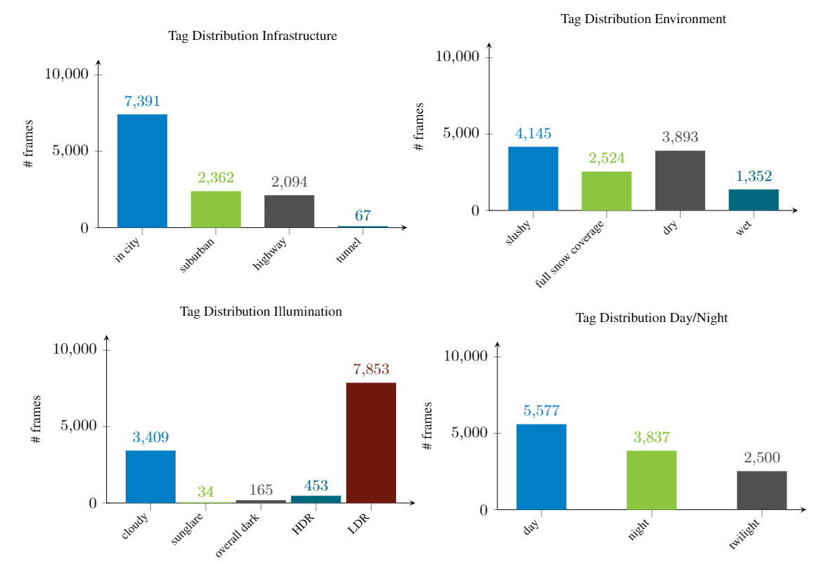
DENSE: Scene Tags
Scene tags:
scene-setting (downtown, suburban, highway).
weather (clear, rain, light fog, dense fog, snow)
derivable path conditions (dry, wet, slushy, full snow coverage)
illumination (low dynamic range, high dynamic range, best computer vision weather, overall dark),
image daytime (day, night, dawn),

Slide 17
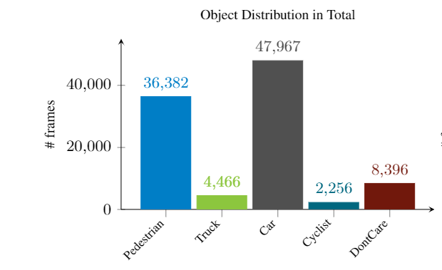
DENSE: Annotations
Both 2D and 3D boxes up to 80m distance in real-world recordings
Only 2d annotations in controlled condition recordings
5 classes: Pedestrian, Truck, Car, Cyclist, and DontCare
Also with the occlusion level (no occlusion, >10 %, >40 % and >80 % occlusion) and the object visibility in each sensor stream.

Slide 18
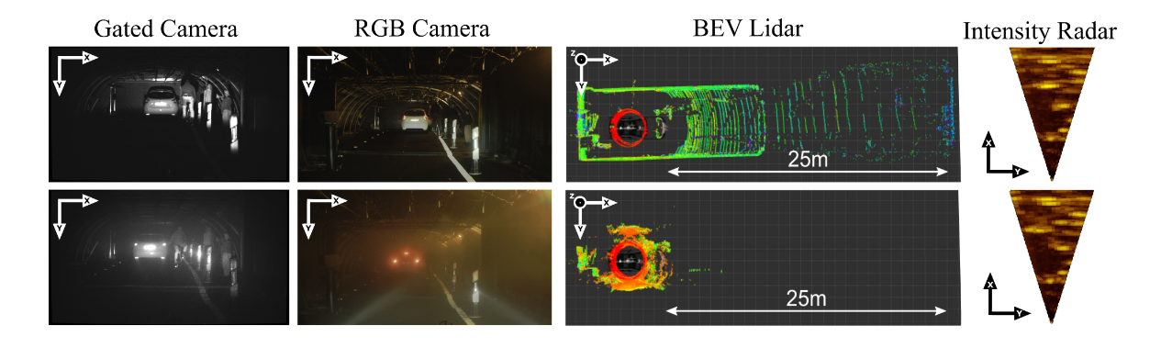
DENSE: Example

Slide 19
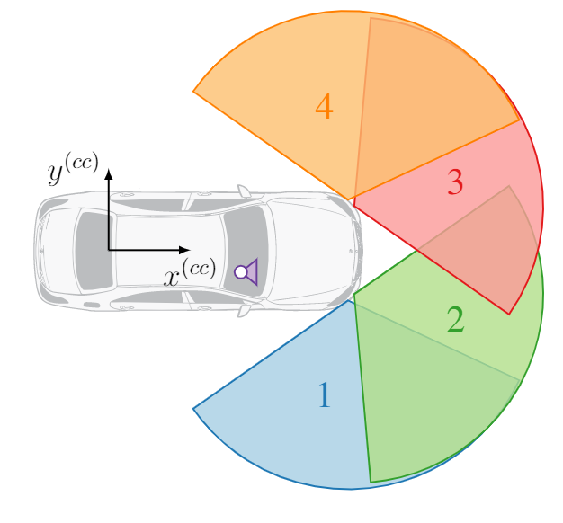
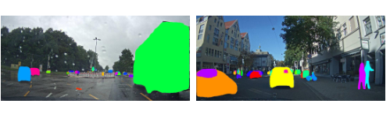
4. RadarScenes: Sensors
77 GHz series production automotive radar sensors + documentary camera
consists only of measurements from the near-range mode with a detection range of up to 100 m
4 radars, each cover 60 °FOV: 1 and 4 were mounted with ±85°with respect to the driving direction, 2 and 3 with ±25
Because of GDPR, road users are anonymized by masking

Slide 20
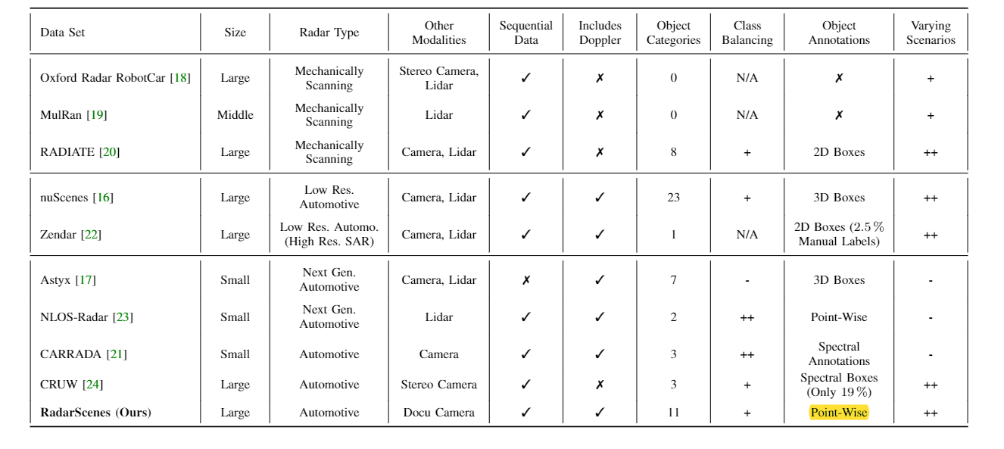
RadarScenes: Features
Radar-only; point-wise annotation; used for radar detection and tracking

Slide 21
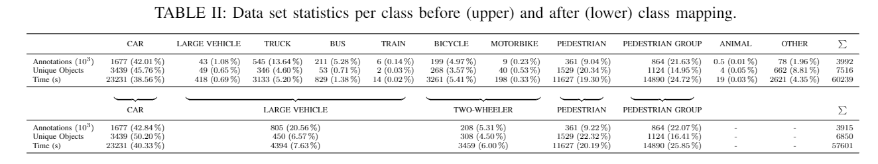
RadarScenes: Data
focus on moving road users, 11 classes with a mapping function
Two labels are assigned to each individual detection of a dynamic object: label id and track id
all detections of the same object have the same track id
over 4 hours and 100 km of driving at a total of 158 different sequences with over 7500 annotations in urban and rural

Slide 22
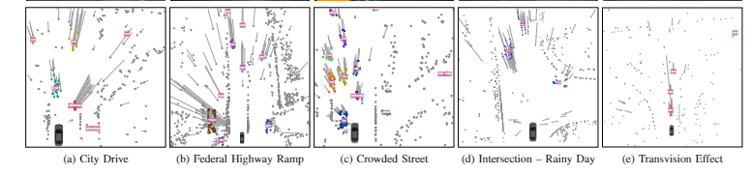
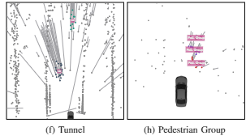
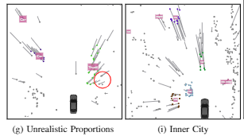
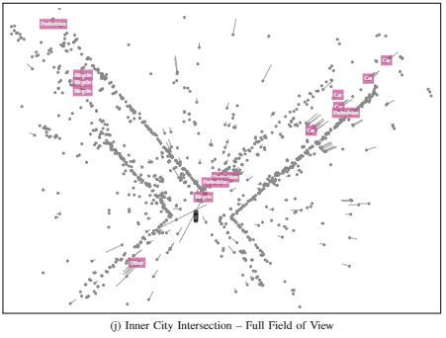
RadarScenes: Examples

Slide 23
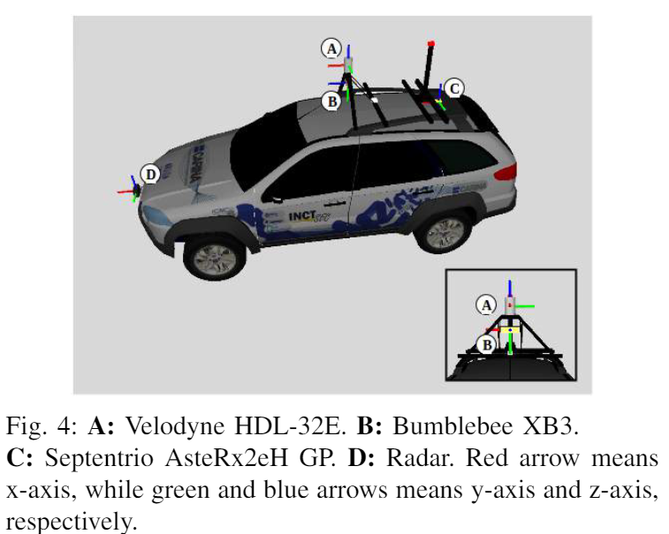
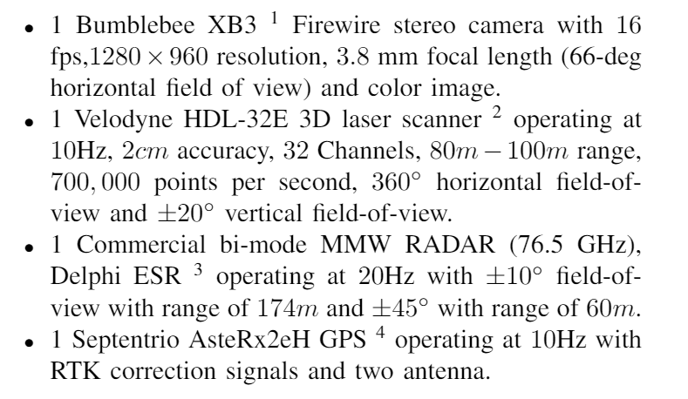
5. CaRINA: Sensors

Slide 24
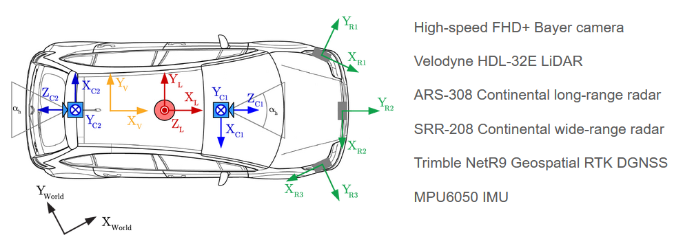
6. Prevention: Sensors

Slide 25
Summary
NuScenes: 3D annotations, 360 view, very popular for 3D detection
PixSet: Raw-data from solid-state lidar, 3D annotations , only front-view, but sensors are co-located (overlapped FOV), can be used for sensor fusion
DENSE:
RadarScenes: Radar-only, 2D point-wise annotations, 360 view, can be used for radar points clustering and tracking
CaRINA:
Prevention: Capture in good weather but with high speed, can be used for trajectory prediction

Slide 26
Pre-CFAR Data
1. CARRADA
2. RADICAL
3. CRUW
4. RADDet
5. ColoRadar
6. SCORP
7. OpenRadar

Slide 27
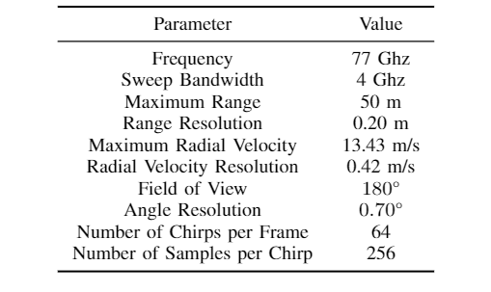
1. CARRADA: Sensors
The image resolution is 1238 × 1028 pixels
Radar: 77Ghz, 2Tx, 4Rx, maximum range 50m, angle resolution 0.7
The range-Doppler and range-angle maps are 256x64 and 256x256

Slide 28
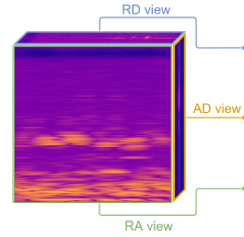
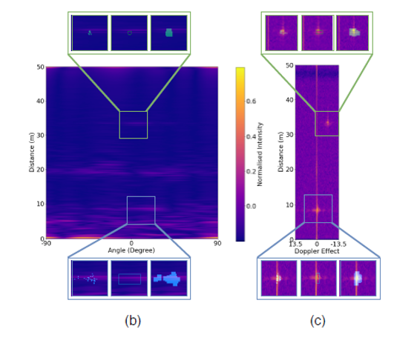
CARRADA: Annotations
One or two objects are moving to simulate urban driving scenarios
38 sequences, 12min, 7193 annotated frames
Provide range-angle map, range-Doppler map and range-angle-Doppler (RAD) tensor
Annotated in both range-angle and range-Doppler representations
Three types of annotations: sparse points, boxes and dense masks

Slide 29
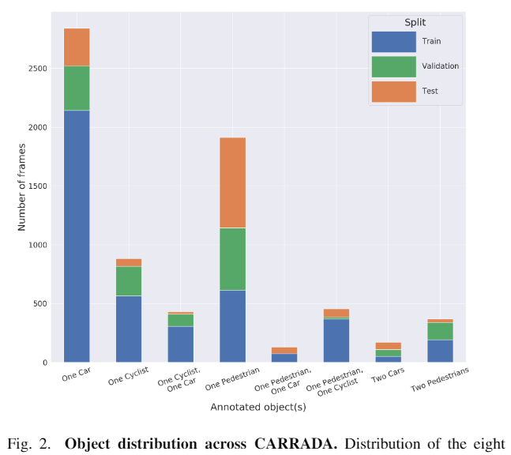
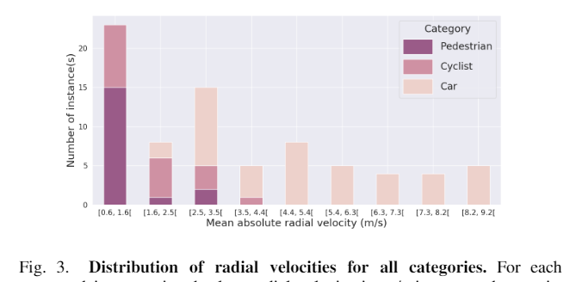
CARRADA: Data Distribution
Simple scenarios and Low speed

Slide 30
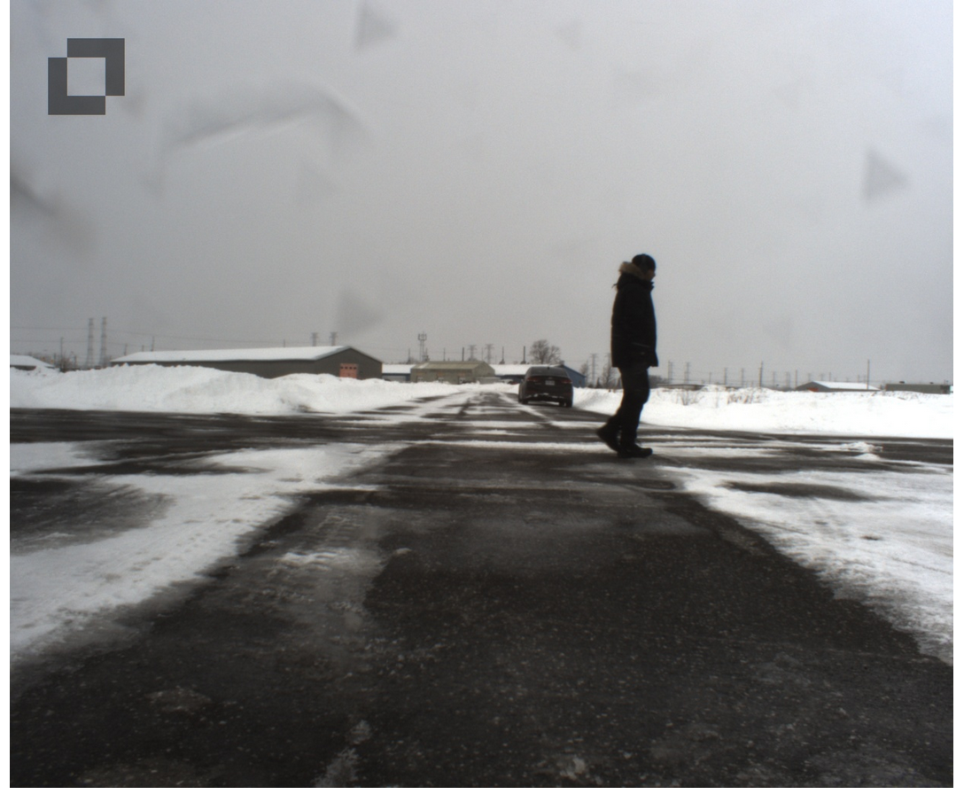
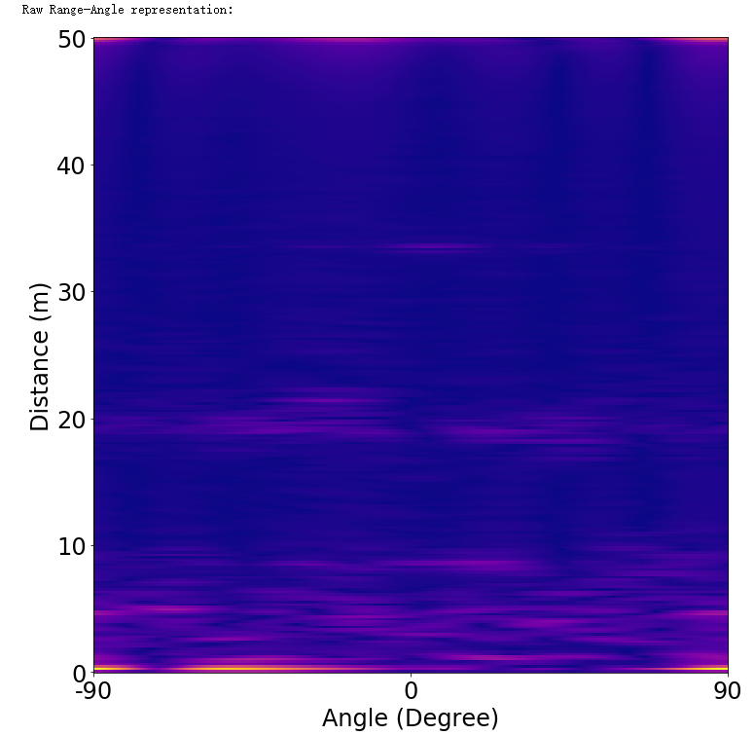
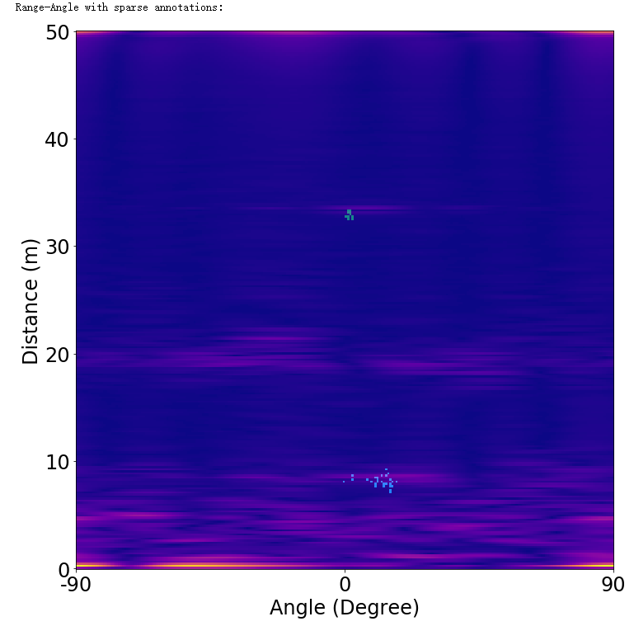
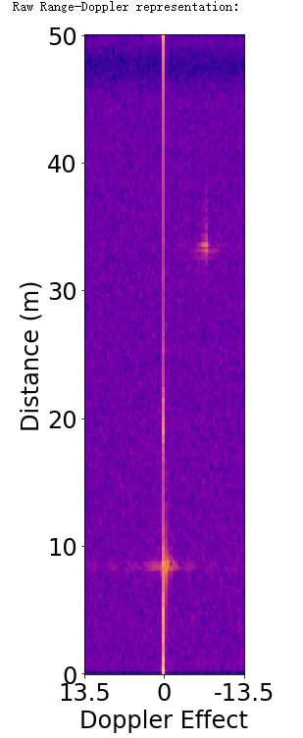
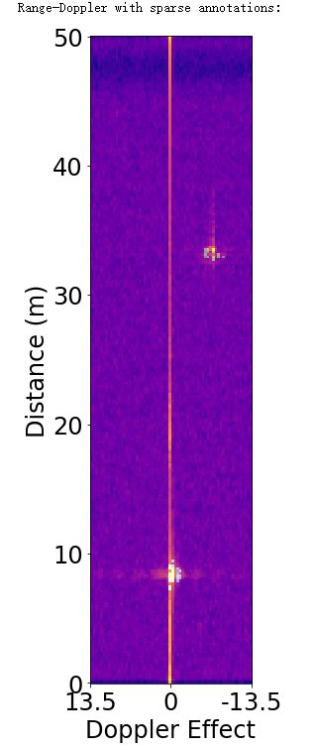
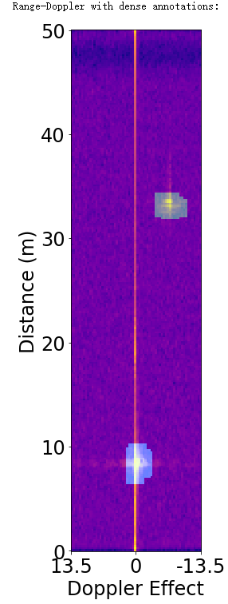
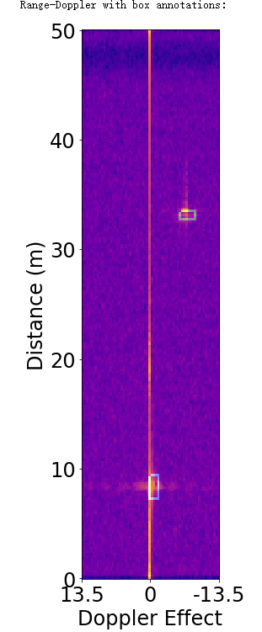
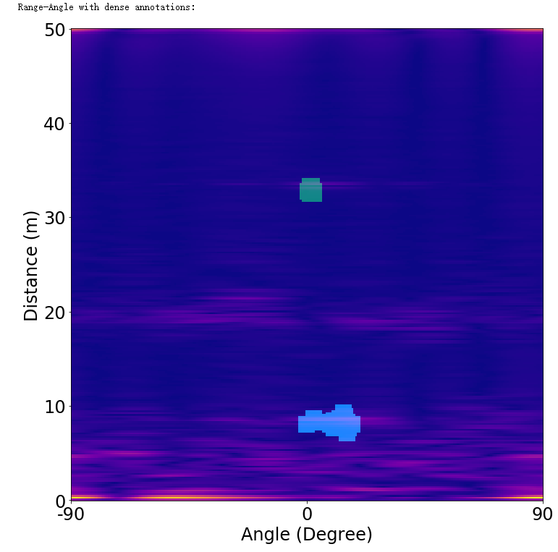
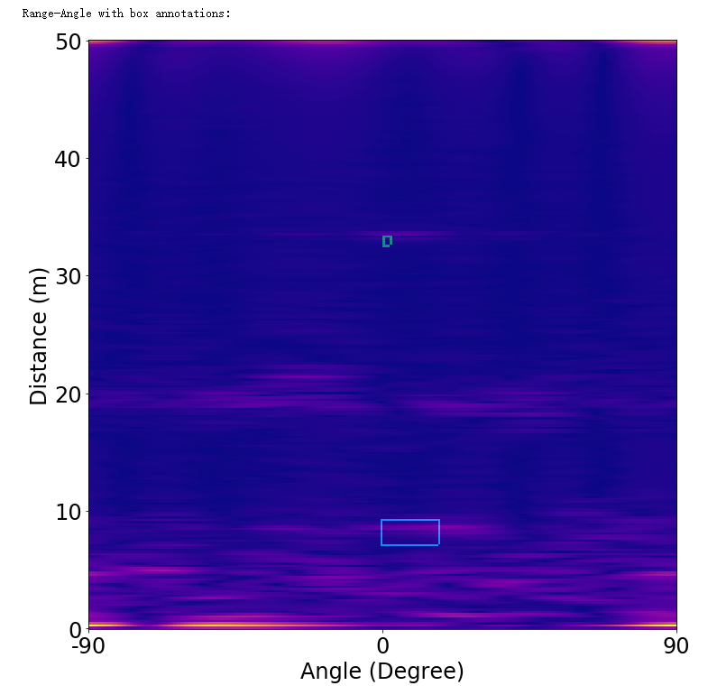
Example

Slide 31


2. RADICAL: Sensors
Realsense D435i RGB-D camera with IMU: 1280x720 RGB images and aligned depth maps at 30fps
depth camera has a maximum depth of approximately 10m.
TI1843: 77Ghz, 3Tx,4Rx
The radar/camera setup was placed in two different positions inside the car

Slide 32

RADICAL: Radar
Increasing the number of transmitting antennas reduces the number of chirps per transmitting antennas which in turn reduces the maximum unambiguous velocity.
we did not enable the elevation transmitter in this dataset so as to improve our maximum unambiguous velocity estimation and velocity resolution

Slide 33

RADICAL: Annotation
Radar records both range-azimuth and range doppler map
Provide spatially and temporal aligned RGBD camera
For each point target, we checked if it was enclosed by a projected bounding box
If it was, we extracted a small patch, 32×32 (1.5m×1.5m), from the cartesian projected heat-map around the point target as a class positive training
Points that were not within a bounding box were labeled as environmental reflectors.

Slide 34

RADICAL: Scenes
Indoor:
lobbies of campus buildings as well as a small eating area, variety of levels of human activity
Outdoor:
The roads driven are a myriad of neighborhood, suburban, highways and city roads.
High Doppler Resolution:
capture the finer micro-Doppler features of human motion.

Slide 35

RADICAL: Configurations
Indoor scenes:
comparable range to our depth camera.
Outdoor scenes:
shorter range, but better resolutions (in both range and Doppler)
longer range and large maximum velocity, but with poorer resolution
High Doppler Resolution:
increases the Doppler resolution of the indoor configuration while lowering the frame rate slightly.

Slide 36

RADICAL: Example
Indoor

Slide 37

RADICAL: Example
Outdoor

Slide 38


3. CRUW: Sensors

Slide 40

4. RADDet: Sensors
TI AWR 1843 Raw ADC size (256, 8, 64) & RAD size (256, 256, 64).
DFK 33UX2733 stereo cameras
set up on the sidewalks and facing the main roads

Slide 41

RADDet: Annotation
3D bounding boxes on RAD tensors and 2D bounding boxes on the Cartesian range maps
Only focus on dynamic road users

Slide 42

RADDet: Data
Sunny weather condition
10158 frames
Provide RAD tensor input
6 classes, 50m distance

Slide 43

5. ColoRadar: Sensors
TI AWR2243 Cascaded Imaging Radar
TI AWR 1843
Ouster OS1 64 beams Lidar
IMU: 300Hz

Slide 44


ColoRadar: Radar
Ti AWR 2243 Imaging Radar

Slide 45

ColoRadar: Data
Raw radar: Complex number for sample index s, chirp index c, receiver index r, and transmitter index t
Range-azimuth-elevation tensor: size of Ne × Na × Nr × 2, where Ne is the number of elevation bins in the heatmap, Na is the number of azimuth bins, and Nr is the number of range bins, 2 is the intensity of the peak in the Doppler velocity spectrum for that location, and the range rate of that peak
Point clouds: Each point is 5 dimension: (x, y, z) , intensity value, and range rate
Less than 300 points per scan

Slide 46


ColoRadar: Scenes
52 sequences, recorded in mines, built environments, and in an urban creek path, more than 145 minutes of 3D FMCW radar, 3D lidar, and IMU data
The pose ground truths are provided, used for odometry

Slide 47


ColoRadar: Examples
Indoor: Aluminium window frames
Outdoor: Pedestrain

Slide 48

6. SCORP: Sensors
Camera: 1280x960 pixels
Radar: 76Ghz, 2Tx 4 Rx, maximum 15m, 90 FoV

Slide 49

SCORP
A moving car equipped with a side view radar and camera in a parking lot with the objective of identifying the drivable open spaces in the scene.
3913 frames, collected in 11 driving sequences.
Provide both input and annotations of RAD tensor, range-azimuth map and range-DOA map

Slide 50
Imaging Radar
1. Zendar
2. Hires2019
3. Hawkeye

Slide 51
1. ZENDAR: Sensors
Camera + VLP 16 Lidar + Radar + GPS/IMU
Radar: 1Tx 4Rx, maximum range 90m and the range resolution is 18cm.
SAR images from a two-meter segment of radar data (i.e., two-meter synthetic apertures). 0.1 azimuth resolution and 1million points per scene

Slide 52

Zendar: Data
Over 11k moving cars labeled in 27 diverse scenes with over 40k automatically generated labels of moving cars in urban
Provide RAD cube (range 512, doppler 256, antenna pair 4) and SAR image with 4 cm pixel width

Slide 53


2. Hires2019: Sensors

Slide 54

Hires2019: Data
500 synchronized frames, 3000 very accurately labeled 3D bounding boxes
7 classes in total (Bus, Car, Cyclist, Motorcyclist, Person, Trailer, Truck)
Attributes : 3D position (x,y,z) , 3D rotation (rx,ry,rz) , 3D dimension (w,l,h) , Class information , Occlusion indicator , Uncertainty (position, dimension)

Slide 55


Hires2019: 4D Radar features

Slide 56

3. Hawkeye: Sensors
2D SAR platform with 60Ghz radar
FOV of 180◦ in azimuth and 35◦ in elevation
20cm X 20cm area is scanned to emulate a 40 X 40 array
5mins scanning time
8◦ angular resolution along azimuth and elevation axes

Slide 57


Hawkeye: Examples
mmWave signals do not scatter as much and mainly reflect off surface making certain portions of the car impossible to image; multipath create artifacts
(b) The 2D sinc function eliminates almost all high frequency perceptual content such as object boundaries; sidelobes create artifacts and noises

Slide 58

Hawkeye: Capture
A wide baseline stereo camera to capture ground truth
327 scenes of cars in 3 types of backgrounds: indoor parking garage, outdoor lot, and outdoor house drive-through
101 in rain or fog
9 categories of cars spanning 60 different model
Distance between 3.3 to 11.9 meters
4000 synthesized scenes for 120 car models.

Slide 59
Spinning Radar
1. OxfordRobot
2. RADIATE
3. Mulran

Slide 60
Simulation
AIODrive

Slide 61

AIODrive: Sensors
Synthetic dataset using Carla simulator
Unrealistic high-resolution sensor modelling

Slide 62

AIODrive
annotations for all mainstream perception tasks
out-of-distribution driving scenarios such as adverse weather and lighting, crowded scenes, high-speed driving, violation of traffic rules, and vehicle crash

